Slide 1









Operational View (OV-1)
“Tactical Recovery of Aircraft And Personnel (TRAP)”
LINK-16
Combat Air Patrol
NED Co Cdr
NATO STANAG 4677
NATO COC
NED Squad Ldr
NED COC
LFCC - Aberdeen
US VMF
NED Plt Cdr
NATO MTF FFI
US VMF
US VMF
NATO STANAG 4677
CAN COC
CAN Co Cdr
DOWNED US PILOT
CAN Plt Cdr
NFCC - MCTSA
US VMF
US Rescue Aircraft
CAN Squad Ldr
LFOC
LHD-8
Horizon
LPD-17
Notes:
There are3 Ways to exchange FFI:
1. Interchange Protocol(IP)-1: Messaging over TCP/IP with header
2. IP2: Same using UDP
3. Service Interchange Profile (SIP3): SOAP Web Service Publish/Subscribe Request Response.
4. Recommend X-509 Certificate Exchange

Slide 2
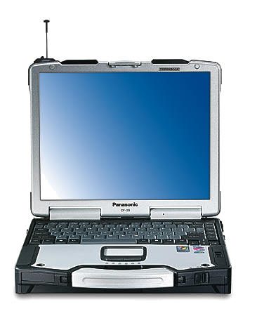
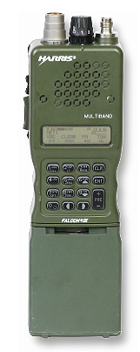
Systems View (SV-1)
“Tactical Recovery of Aircraft And Personnel (TRAP)”
NIEM DATA BROKER
NATO
DATA
BROKER
LINK-16
LINK-16 Display
NATO STANAG 4677
NED TACTICAL SA DEVICES
GCSS(J)
NED SA DISPLAY SYSTEM
LFCC - Aberdeen
US VMF
NATO MTF FFI
US VMF
NATO STANAG 4677
US VMF
CAN TACTICAL SA DEVICES
US BFT
TRANSPONDER
CAN SA DISPLAY SYSTEM
TACDS
US VMF
GCSS(J)
US VMF
NFCC - MCTSA
GCSS(J)
JCTW
Notes:
There are3 Ways to exchange FFI:
1. Interchange Protocol(IP)-1: Messaging over TCP/IP with header
2. IP2: Same using UDP
3. Service Interchange Profile (SIP3): SOAP Web Service Publish/Subscribe Request Response.
4. Recommend X-509 Certificate Exchange

Slide 3
INFORMATION EXCHANGE
“Tactical Recovery of Aircraft And Personnel (TRAP)”
ENTITY | REPORT FORMAT | XML EXCHANGE | REPORT FORMAT | ENTITY | PURPOSE
Downed Pilot | US VMF | US VMF to STANAG 4677 | STANAG 4677 | NATO FWD HQ | Pilot Position displayed on NATO C2 System
NATO FWD HQ | NATO MTF FFI | NATO MTF FFI to STANAG 4677 | STANAG 4677 | NED HQ | Pilot Position displayed on NED C2 System
NATO FWD HQ | NATO MTF FFI | -- | NATO MTF FFI | CAN HQ | Pilot Position displayed on CAN C2 System
CAN THROUGH NATO FWD HQ | NATO MTF FFI | NATO MTF FFI to NATO LINK 16 | NATO LINK 16 | NATO COMBAT AIR PATROL | CAN Ground Tracks visible on NATO Air Platform System
NED THORUGH NATO FWD HQ | STANAG 4677 | STANAG 4677 to NATO LINK 16 | NATO LINK 16 | NATO COMBAT AIR PATROL | NED Ground Tracks visible on NATO Air Platform System
US LFOC | STANAG 4677 | STANAG 4677 to US LINK 16 | US LINK 16 | RESCUE AIRCRAFT | All NATO Ground tracks visible on US Air Platform System
NATO FWD HQ | STANAG 4677 | STANAG 4677 to US VMF | US VMF | US LFOC | NED Ground Tracks visible on US C2 System
NATO FWD HQ | NATO MTF FFI | NATO MTF FFI to US VMF | US VMF | US LFOC | CAN Ground Tracks visible on US C2 System

Slide 4
XML INFORMATION EXCHANGE PRODUCT DOCUMENTATION
“AIR GROUND SITIUATIONAL AWARENESS DATA EXCHANGE”
NATO MTF XML SCHEMA - FFI
STANAG 4677 XML SCHEMA - POSREP
NATO GOE MTF EXTENSION SCHEMA
NATO LINK 16 XML SCHEMA – GROUND POS
Information Exchange Product Documentation(IEPD)
- XML Field Re-Use
- Business Rules
- XML Transformations
- Web Service Discovery / Syndication
NATO MTF
FFI INSTANCE
STANAG 4677 POSREP INSTANCE
NATO LINK 16 GROUND POS INSTANCE

Slide 5
INFORMATION EXCHANGE
“Tactical Recovery of Aircraft And Personnel (TRAP)”
Information Exchange Requirements:
Selected Shared Situational Awareness For:
NATO FWD HQ (NATO HQ)
NED Ground Forces Attached to NATO (NED)
CAN Ground Forces Attached to NATO (CAN)
NATO Combat Air Patrol (NATO-AIR)
US Landing Force Operation Center (LFOC)
US Naval Force Combatant Commander (NFCC)
US Land Force Combatant Commander (LFCC)
US Rescue Aircraft (US-TRAP)
US Downed Pilot (US-Pilot)
Policy Roles:
NATO HQ sees ALL entities in AO.
NED sees US-Pilot and CAN
CAN sees US-Pilot and NED
NATO-Air sees NED, CAN,US-TRAP and US-Pilot
LFOC sees NED, CAN,US-TRAP and US-Pilot
NFCC sees US-TRAP and US-Pilot
LFCC sees NED, CAN, US-TRAP and US-Pilot
US-TRAP sees NED, CAN and US-Pilot
Operational Rationale:
1. LFOC will execute TRAP mission and must have NED and CAN SA to prevent offensive actions by US-TRAP against NATO forces in the vicinity.
2. NATO HQ will provide SA to NED and CAN to prevent offensive actions against US-Pilot and US-TRAP, and to defend US-Pilot against enemy attack.
3. NFCC requires Command SA for US-TRAP and US-Pilot but does not require NED and CAN SA.
4. LFCC requires Command SA for US-TRAP, US-Pilot, NED and CAN due to attached US Army Personnel.
5. NATO-AIR requires SA for NED, CAN, US-Pilot and US-TRAP to prevent offensive actions against NATO and US personnel.

